Slide 1
Geographic Information System (GIS) IS 454
Lecture 3: The Nature of Geographical Data
MS. Zanabi Bager
Computer IS department
College of CS and IT

Slide 2
The Nature of Geographical Data
Geographical phenomena
Spatial autocorrelation and scale
Spatial sampling
Spatial interpolation
Uncertainty of geographical data

Slide 3
Geographical phenomena
Our behaviour in space often reflects past patterns of behaviour.
Some geographical phenomena vary smoothly across space, while others may not.
The first law of geography: everything is related to everything else, but near things are more related than distant things.
  This property is known as spatial autocorrelation.

Slide 4
Spatial autocorrelation and scale
Spatial autocorrelation:
  Measurements on how near and distant things are interrelated.
Temporal autocorrelation:
  The relationship between consecutive events in time.
Examining spatio-temporal processes:
  explanation in time need only look to the past, but
  explanation in space must look in all directions simultaneously.

Slide 5
Spatial autocorrelation and spatial objects
Spatial autocorrelation deal simultaneously with similarities in the location of spatial objects.
It is determined both by similarities in position, and by similarities in attributes
Indices are used to measure spatial autocorrelation of objects.
  Moran’s I
  Geary’s C
  Ripley’s K

Slide 6
Types of spatial objects
Spatial objects are classified according to their topological dimension, which provides a measure of the way they fill space.
Point – dimension 0
Line – dimension 1
Area – dimension 2
Volume – dimension 3
Time – usually considered to be the fourth dimension of spatial objects, although GIS is currently incapable of dealing with it properly.

Slide 7
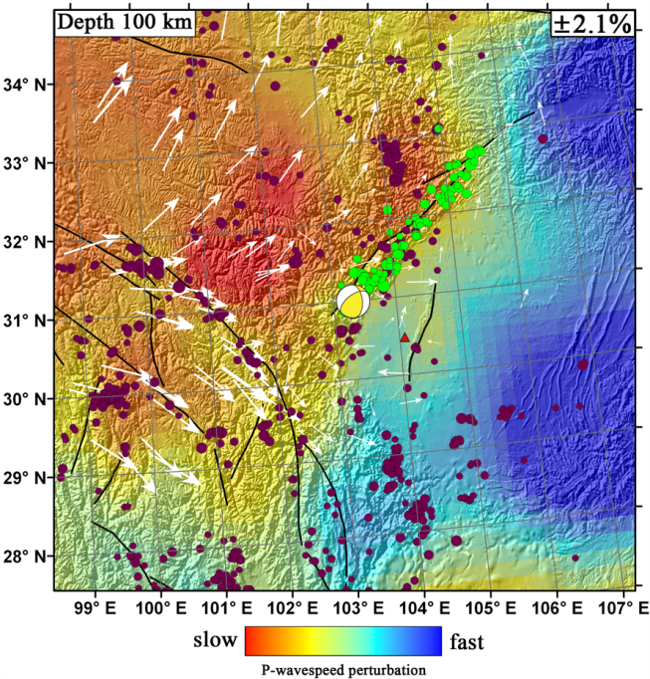
Point
A point object has neither length nor breadth nor depth.
May be used to indicate spatial occurrences or events, and their spatial pattern.

Slide 8
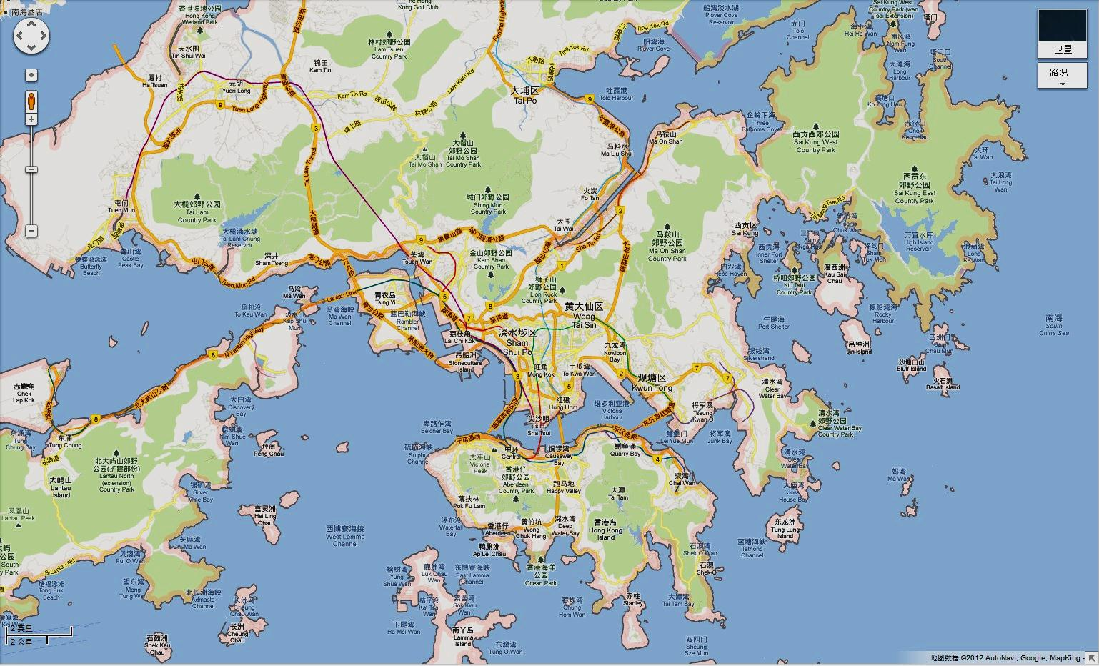
Line
A line object has length, but not breadth or depth.
Used to represent linear entities that are frequently built together into networks.
Also used to measure distances between spatial objects.

Slide 9
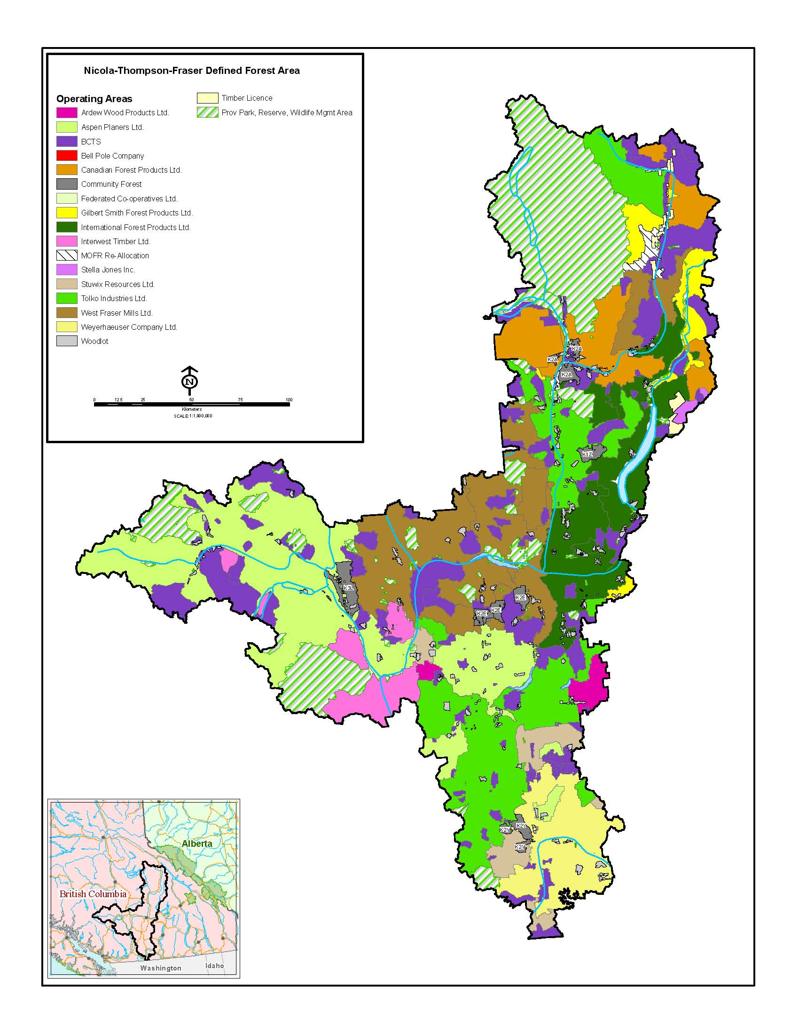
Area
An area object has two dimension, length and breadth, but not depth.
Represents enclose areas of natural or artificial objects.

Slide 10
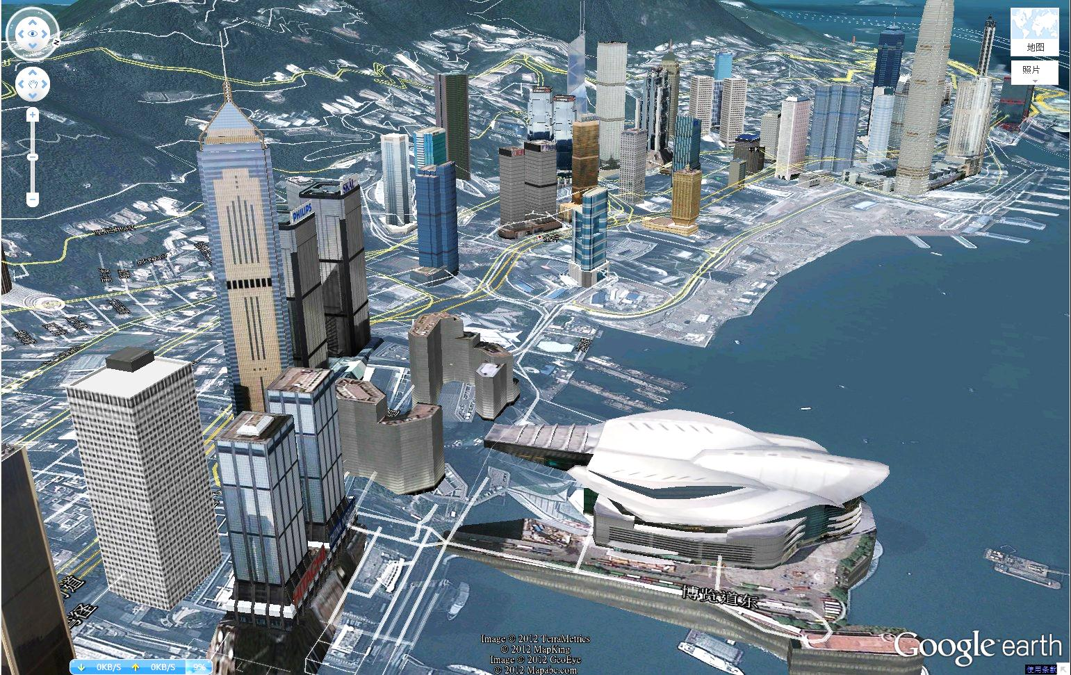
Volume
A volume object have length, breadth and depth.
Used to present natural (e.g. mine bodies and buildings) or artificial objects.

Slide 11
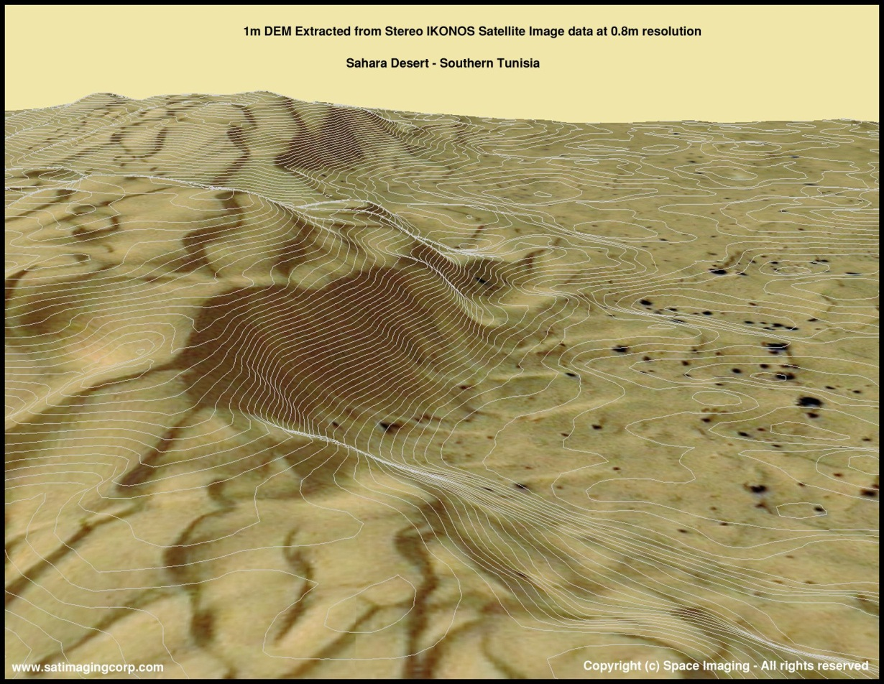
Surface
A surface is a kind of volume object but its depth is actually the spot height of the surface.
Used to present natural or statistical surface objects.

Slide 12
Types of attributes
Normal attribute types
  Nominal
  Ordinal
  Interval
  Ratio
Categories beyond the normal types
  E.g. cyclic (0 – 360°)
  Average of 1° and 359° = ?

Slide 13
Positive, negative and zero spatial autocorrelation
Positive: features are similar in location are also similar in attributes.
Negative: features that are close together in space tend to be more dissimilar in attributes than features that are further apart.
Zero: attributes are independent of location.

Slide 14
Spatial autocorrelation
A
B
C
D
E
(A) Extreme negative spatial autocorrelation; (B) a dispersed arrangement; (C) spatial independence; (D) spatial clustering; and (E) extreme positive spatial autocorrelation.

Slide 15
The meaning of scale
Level of spatial detail in data
Geographical extent or scope of a project
  e.g. a large-scale project covers a large area.
  A small-scale project covers a small area.
Scale of a map: representative fraction (RF)
Scale is often integral to the trade off between the level of spatial resolution and the degree of attribute detail that can be handled for a given application.

Slide 16
Level of resolution
A
B
(A) A coarse-scale representation of attributes in a pattern of negative spatial autocorrelation. (B) The pattern of spatial autocorrelation at the coarser scale is replicated at the finer scale. The overall pattern is said to exhibit the property of self-similarity.

Slide 17
Spatial sampling
Self-similar structure is characteristic of natural as well as social systems.
  A rock may resemble the physical form of the mountain.
  A small group ‘typical’ people’s opinion may resemble that of the society.
Sampling is therefore the typical way to gain geographical data.
Geographical data are only as good as the sampling scheme used to create them.

Slide 18
Spatial sampling schema
A
B
C
D
E
F
G
Spatial sample designs: (A) simple random sampling; (B) systematic sampling; (C) systematic sampling with local random allocation; (D) systematic sampling with random variation in grid spacing; (E) clustered sampling; (F) transect sampling; and (G) contour sampling.

Slide 19
Spatial interpolation
In sampling, part of reality to hold within our representation.
Judgement is required to fill in the gaps between the observations.
This requires understanding of the likely attenuating effect of distance between samples.
The function that fills the gaps is known as interpolation function.

Slide 20
Interpolation function
Linear
Quadratic
Generic form:
Cubic

Slide 21
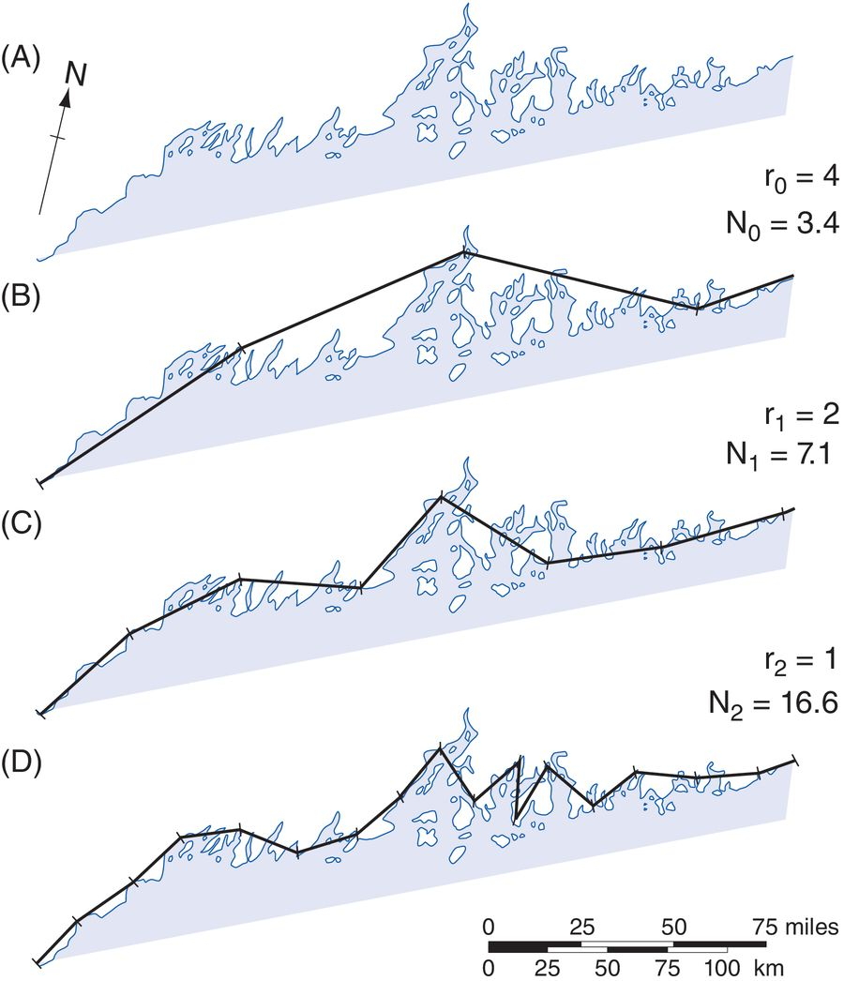
The length of coast line problem
How long is a coast line?
  Indeterminate
  Scale-dependent
The coastline of Maine, at three levels of recursion: (A) the base curve of the coastline, (B) approximation using 100-km steps, (C) 50-km step approximation, and (D) 25-km step approximation.
(Source: Longley et al. 2016, pp52)

Slide 22
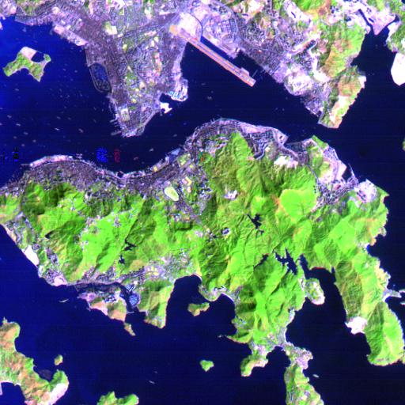
Example of Coast line
Coast line of a city: The length of the coastline increases with the increasing level of details and scale. The precise length of the coast line is indeterminate.

Slide 23
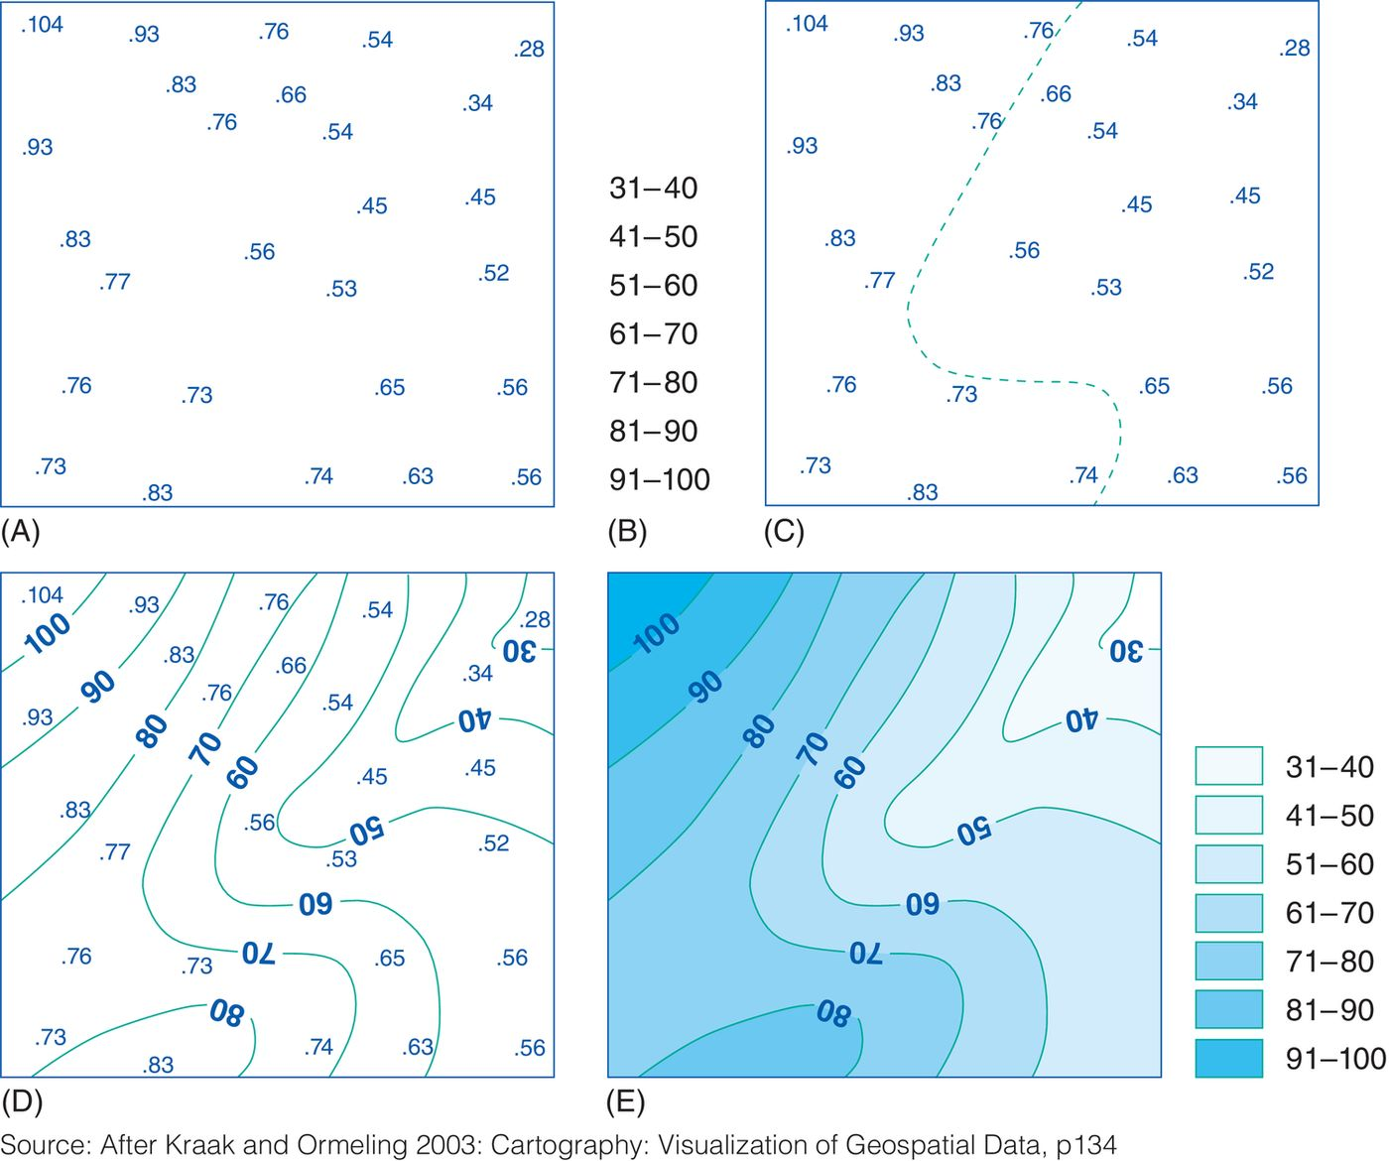
H.W: Write a report to explain how the temperature is visualized ?

Slide 24
Summary
The law of geography states the property of spatial autocorrelation.
Spatial autocorrelation is the measurements on how near and distant things are interrelated.
Spatial objects are classified according to their topological dimension, which provides a measure of the way they fill space.
Geographical data are only as good as the sampling scheme used to create them.
Interpolation is the function that fills the gaps in samples.

